Slide 1


Extract Trends from social media data
Team Name: Iconic
Institute Name: Army Institute Of Technology

Slide 2
Team members details
Team Name | Iconic
Institute Name | Army Institute Of Technology
Team Members | 1 | 2 | 3
Name | J Girish (Leader) | Himanshu Yadav | Pawan Kumar
Batch | Information Technology | Information Technology | Information Technology

Slide 3
Glossary
Trending Score logic: likes + retweets + followers*0.4
API: Application Programming Interface it is the part of the server that receives requests and sends responses
Tweepy: Tweepy is an open-sourced, easy-to-use Python library for accessing the Twitter API.
BeautifulSoup: Beautiful Soup is a library that makes it easy to scrape information from web pages.

Slide 4
Use-cases
Trending products image’s is also extracted for displaying along with product details
This will help for seller in Flipkart to customize their products list
Our solution will have the trending products from twitter

Slide 5
Solution statement / Proposed approach
P0: In our solution we are using tweepy (python library ) as it is open source
P1: The stored key words like (hashtags, famous twitter handles etc..) will be used to search product name in tweets ex:- #iphone13, realme earbuds air ,#shirt etc.. . By using product name as Lenovo ideapad 3 we will check if a product name exists in the tweet like Lenovo ideapad 3 if it exists, Then we mark it as valid tweet
P2: From the stored data of key words(hashtags, famous twitter handles etc..) we fetch 100 tweets
P3: All the information extracted is stored in list of map data set which is needed in future scope (ex:- likes, followers of that twitter ID, product name, image of that product, tweet, hashtags related to that tweet etc..
P5: By using beautifulsoup we search for the product name in flipkart site and search if our product exists in flipkart then we also store the product’s flipkart link in our data

Slide 6
P5:Then we filter the data so that we only take tweets which are having product name in the tweet or hashtags, removing duplicate tweets and ignoring unwanted tweets so that storage and processing can be optimized.
P6: Sort the data in ascending order by keeping trending score as reference and then convert list of map data set to json type file
P7: For back-end we are using Flask which will send the requested data to our Front-end (React js)
P8: Sending the requested data from json file to our client (Front-end) we are using react js to display all the trending products in front-end
P9: The result of the Social Media Trends is displayed at client side.
P10: The whole process is repeated in a interval of 3 days

Slide 7
Process flowchart
Start

Slide 8
Limitations
There are many bots in twitter which can manipulate like,retweets or followers in twitter so trending score gets affected.
The products related to e-commerce have very low to no viwes and likes in twitter (and other social media sites like:- redit,instagram,facebook)
There is rate limit in twitter API 900 requests/15 minutes is allowed any think above this treated as error
There are products in tweeter where data is incorrect which leads to wrong display of image or product details.
We are focusing on Electronis,Fashion and Phone’s category so we are limiting the category.

Slide 9
Future Scope
P1: We will also recommend the products that are trending in social media sites but not their in Flipkart.
P2: We will also display the region and time period of a particular type of product whose trend is increasing.
P0: We will extract key words(similar products name in flipkart or other e-commerce sites) from the tweets by training a model to extract keywords from tweets using meachine learning to optimise the pocess.

Slide 10
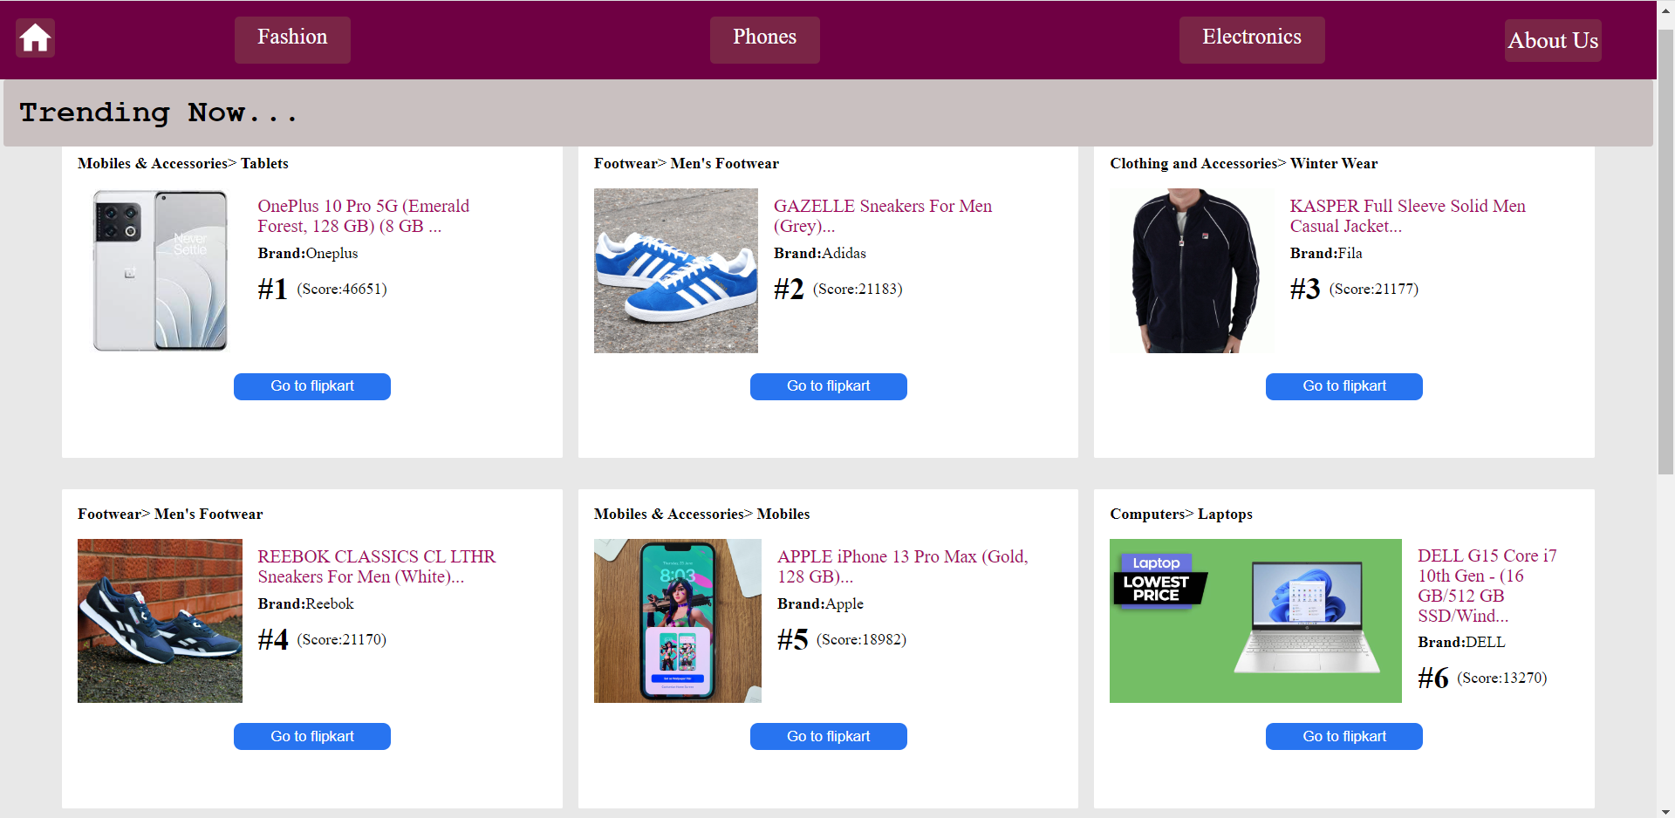

Slide 11
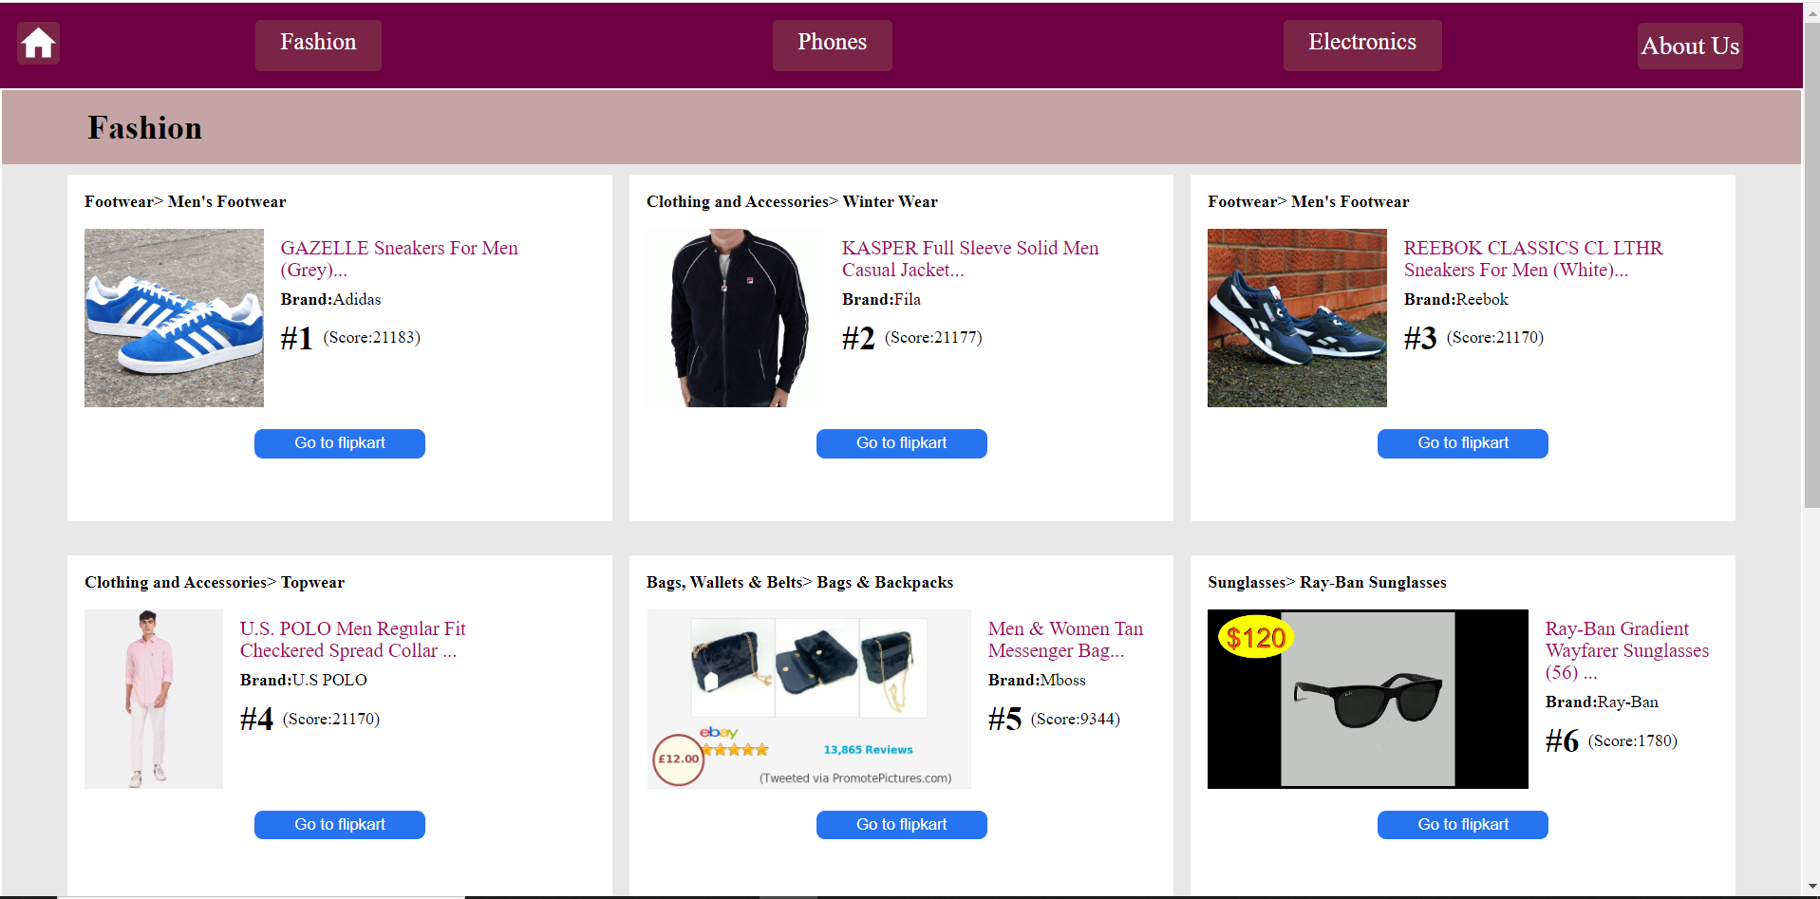

Slide 12
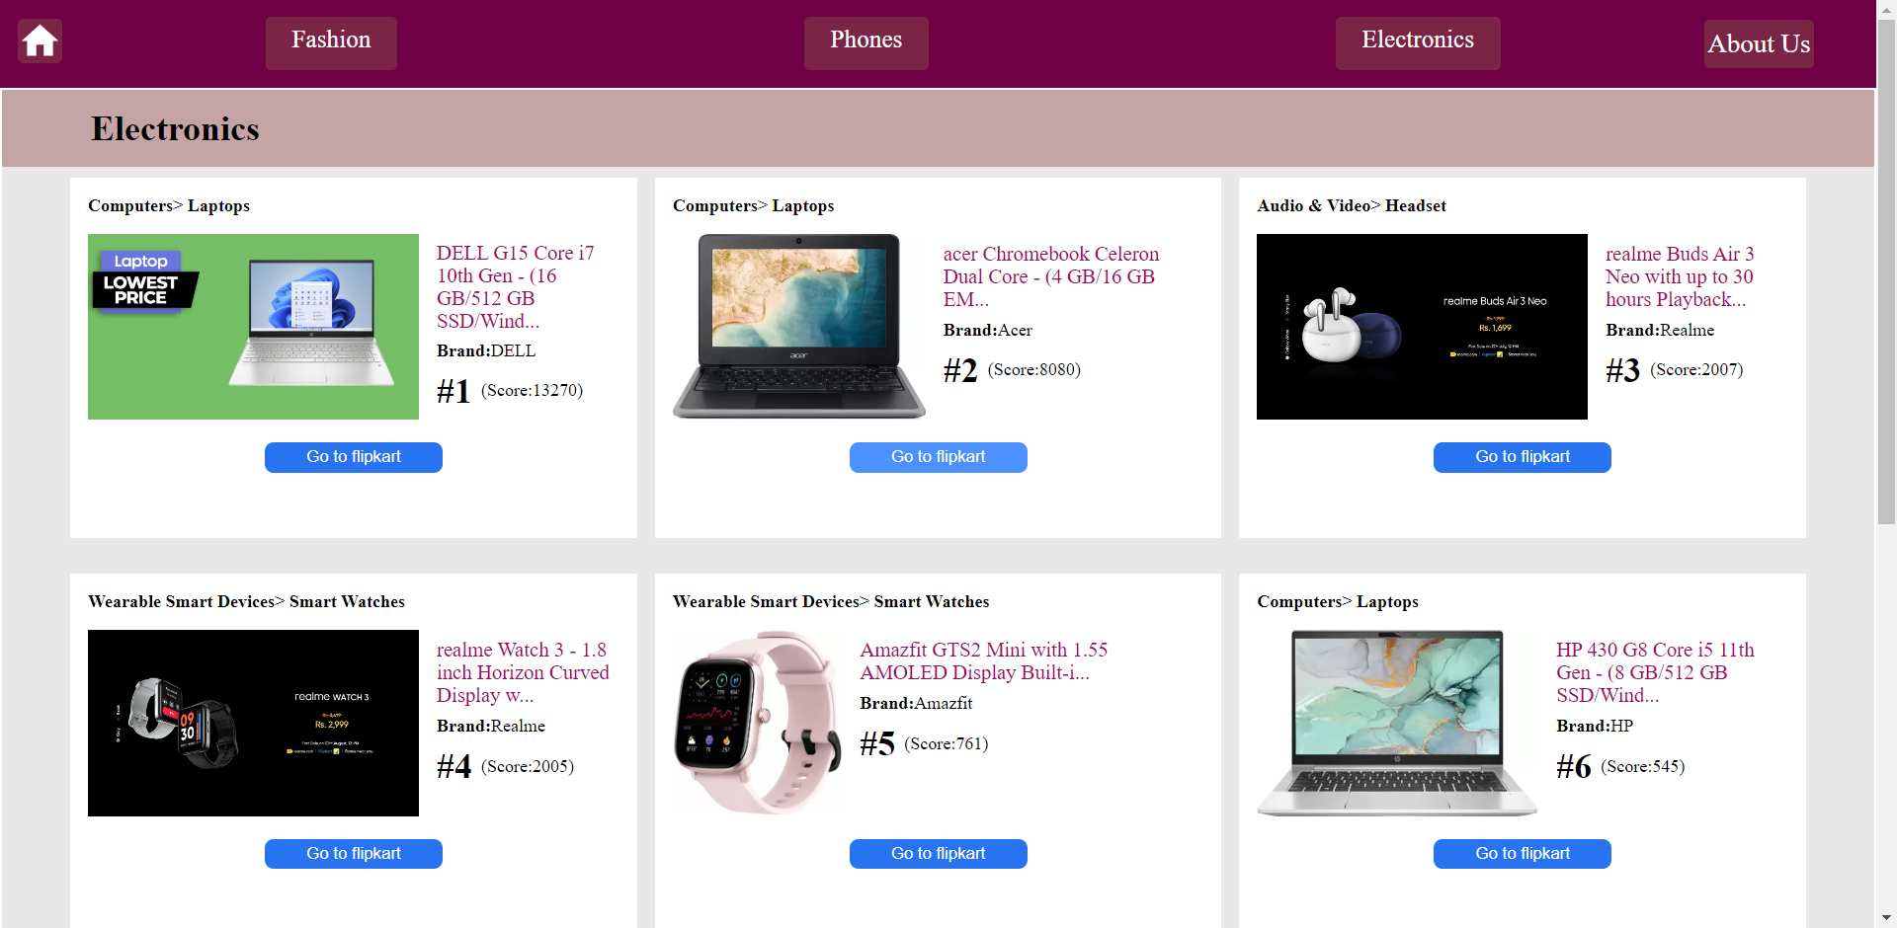

Slide 13
THANKS

